Slide 1

















HOUSING RENTAL SYSTEM
Harmi Mathukiya – 21104044 Atharva Mohape – 21104121 Anurag Gupta – 21104109 Shubham Gupta - 21104043
Project Guide
Ms. Manasi Choche

Slide 2
Contents
Introduction
Objectives
Scope
Features / Functionality
Project Outcomes
Technology Stack
Block Diagram

Slide 3

1. Introduction
Problem Identified :
Manual Documentation Problem.
Waste Of Time And Money.
Solution Proposed :
Legal Document And Other Things On This App.
Savings Of Time And Money.

Slide 4

2. Objectives
To encourage a range of affordable, accessible, and decent rental
housing option throughtout the community.
To facilitate home record keeping for who wants home and for administrative management system.
To provide a fully functional automated home Rental Management System that will be an online system.
To develop an efficient application that will be helpful for not only
members but also landlords.

Slide 5

3. Scope
Can be useful for the system which will remove the tedious task of
customers for searching home for rental.
Can be applied by any business organisation.
More over it provides facility to its customer.
The proposed system is concerned searching a home rental, payment and account controls in online way.
The system will help to the home administrative staff i.e the Home Rental to keep the daily and the history record details of the customers need in proper database.

Slide 6
4. Feature /Functionality
1. FEATURE 1 :
Both owner and tenants can operate it via computer/smartphone/tabs
with the help of internet.
Tenants and owner can uploads their attachments in image file, pdf, ppt, doc
2. FEATURE 2 :
Admin can see the list of all property details.
Owner and police get the information of tenants easily if renter registered this software.
3. FEATURE 3 :
Tenants can be rating a house after staying that house.

Slide 7

5. Outcome of Project
Managing the levels of the project is pretty easy and so is storing the
details of house and users.
It is easy to maintain up to date information and is cheaper to maintain.
There will be complain box for renter.
Ambulance service can be easily provide.
Owner can receive money by online banking service.

Slide 8




6. Technology Stack
1. FRONTEND (Language Used) :-
HTML
CSS
JAVA
2. BACKEND (Database Used) :-
MYSQL

Slide 9

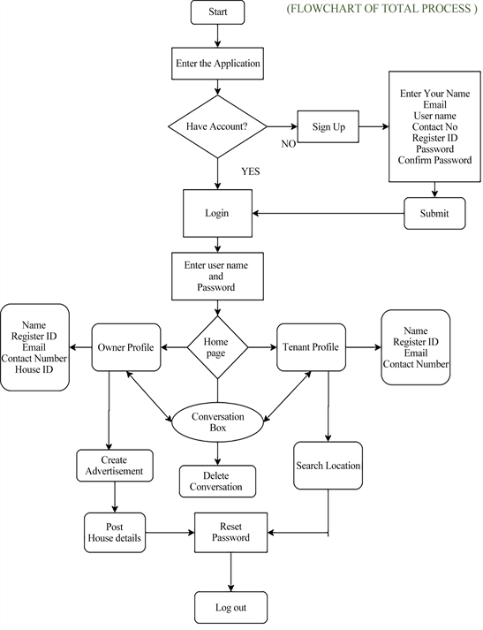
7. Block Diagram

Slide 10
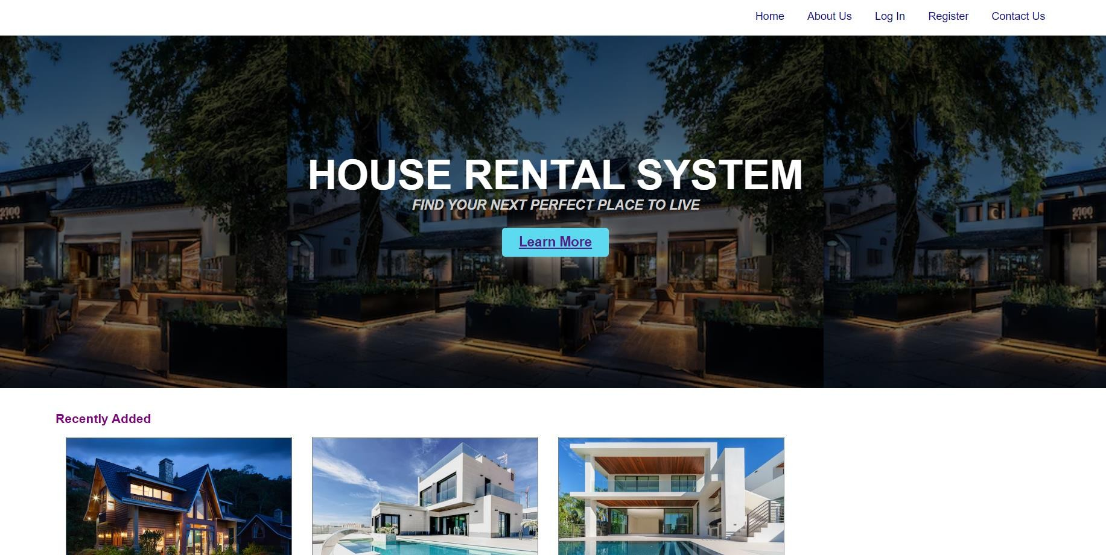
FRONTEND:

Slide 11
Thank You...!!

